Slide 1
Benchmarking and Analysis of Deep Learning methods to classify EEG Motor Movement / Imagery signals
CSCI-566 - Deep Learning Project - Group 18

Slide 2
Objective
Compare and benchmark the performance of current Deep Learning methods to classify EEG signals for Motor Movement / Imagery.
Analyze robustness of models to noise
The study aims to offer insights to optimize EEG data classification for BCI applications.
Group 18
Benchmarking and Analysis of Deep Learning methods to classify EEG Motor Movement / Imagery signals
Notes:
Essential for advances in neurotechnology and brain computer interfaces

Slide 3
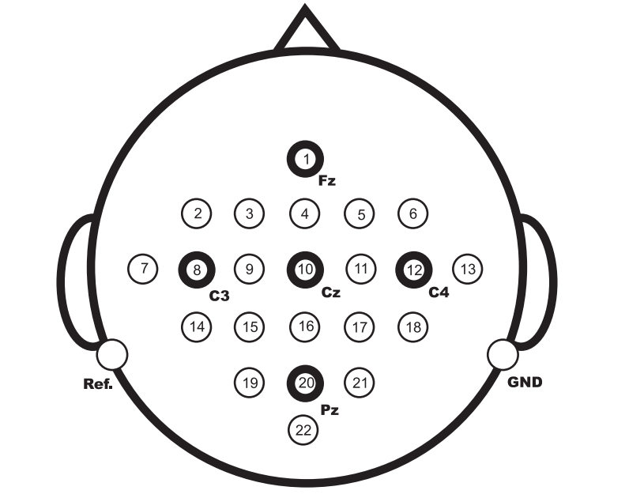
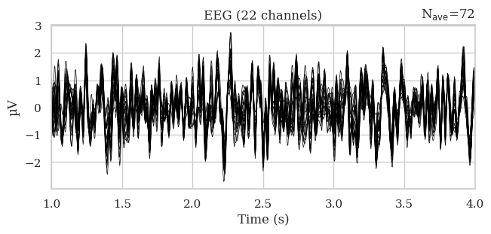
Dataset - BCI-Competition-IV-2a
Dataset description
Subjects: 9
Trials: 288 x 18 = 5184
Channels: 22 EEG + 3 EOG
Sampling frequency: 250 Hz
Frequency range: 0.5 to 100 Hz
Format: GDF
Target classes
Left hand
Right hand
Feet
Tongue
Group 18
Benchmarking and Analysis of Deep Learning methods to classify EEG Motor Movement / Imagery signals
Notes:
Two sessions on different days were
recorded for each subject. Each session is comprised of 6 runs separated by
short breaks. One run consists of 48 trials (12 for each of the four possible
classes), yielding a total of 288 trials per session.
Each session includes both movement and imagery signals

Slide 4
Approach
Preprocessing
Bandpass filtering: 4 - 38 Hz
Exponential moving standardization
Split into windows: 5184
Feature Extraction
Wavelet Packet Decomposition
Common Spatial Pattern
Graph Embedding
Train - Test split
Model Training
Robustness to noise - SNR 15
Group 18
Benchmarking and Analysis of Deep Learning methods to classify EEG Motor Movement / Imagery signals
Notes:
Motor imagery tasks usually happen in the alpha and beta range of EEG signals
WPD is a wavelet transform where the discrete-time (sampled) signal is passed through more filters than the discrete wavelet transform (DWT). 8 freq band coefficients are chosen from the range 4-32Hz and wavelet packets are generated
CSP - used in signal processing for separating a multivariate signal into additive subcomponents which have maximum differences in variance between two windows
Graph embedding - electrodes are considered as nodes and then vectors are generated from that
Noise SNR 15, 98 simliarity

Slide 5
Models
Raw Dataset
MLP
Shallow ConvNet
Deep ConvNet
EEGNet
EEGConformer
ATCNet
EEGITNet
WPD CSP
MLP
CNN
ConvLSTM
ShallowFBCSP
Group 18
Benchmarking and Analysis of Deep Learning methods to classify EEG Motor Movement / Imagery signals
Notes:
Shallow conv - temporal con, spatial filter, + 2 conv
Deepconv - 4 conv
Eegnet - conv, depthwise and separable conv
Conformer - cnn - attention
Atc - conv, attention, temporal conv
It - interpretable
Deep4net
Shallowfbcsp - (FBCSP) to perform autonomous selection of key temporal-spatial discriminative EEG characteristics

Slide 6
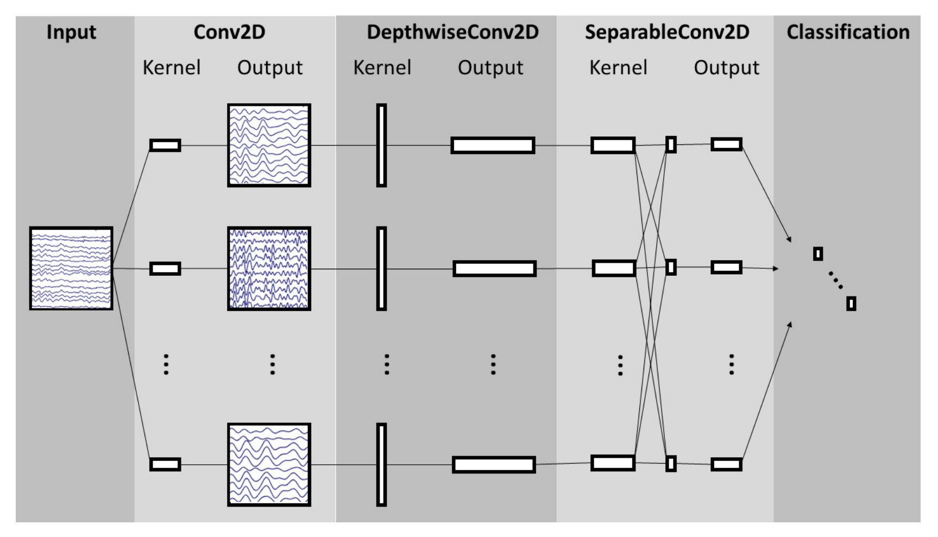
Models - EEGNet
Group 18
Benchmarking and Analysis of Deep Learning methods to classify EEG Motor Movement / Imagery signals
Notes:
Depthwise conv - each timestep is convolved across all channels, - to capture spatial relation
Separable - proposed to compute it faster. It performs a depthwise spatial convolution followed by a pointwise convolution which mixes together the resulting output channels. Captures relationships across channels

Slide 7
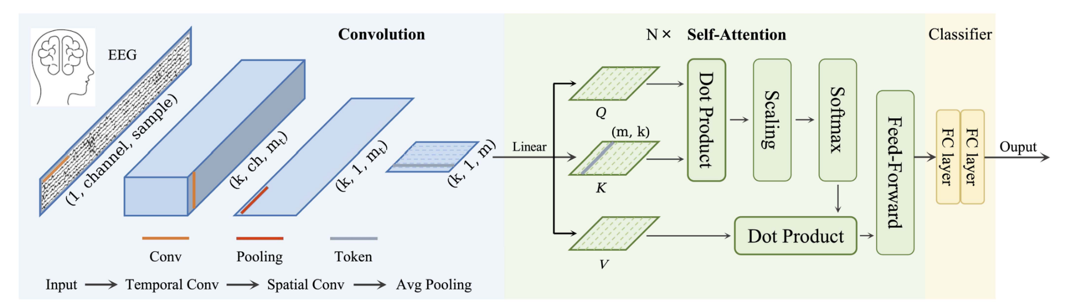
Models - EEGConformer
Group 18
Benchmarking and Analysis of Deep Learning methods to classify EEG Motor Movement / Imagery signals
Notes:
Depthwise conv - across all channels, each timestep is convolved - to capture spatial relation
Separable - proposed to compute it faster. It performs a depthwise spatial convolution followed by a pointwise convolution which mixes together the resulting output channels. Captures relationships across channels

Slide 8
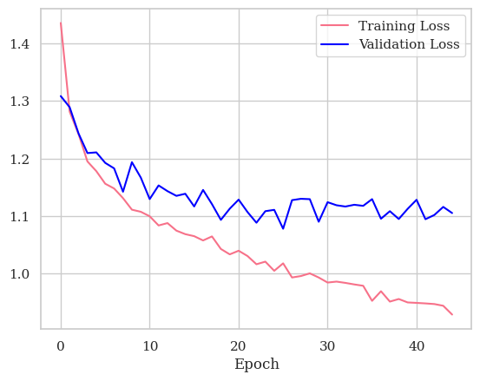
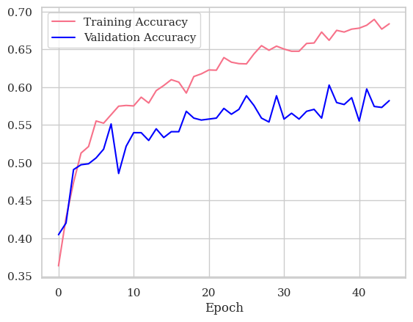
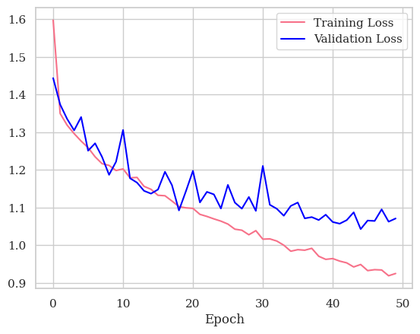
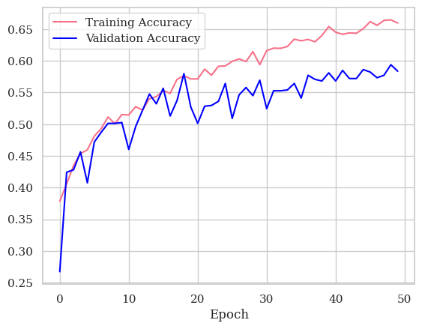
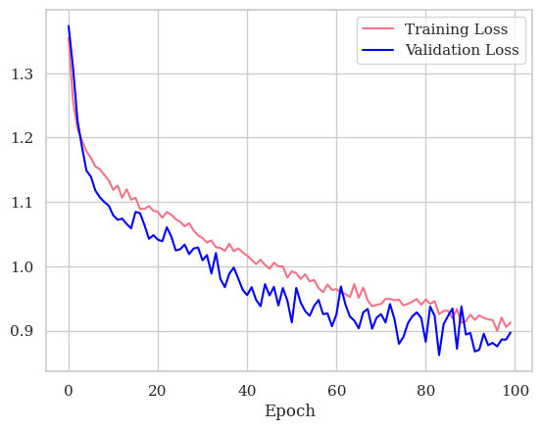
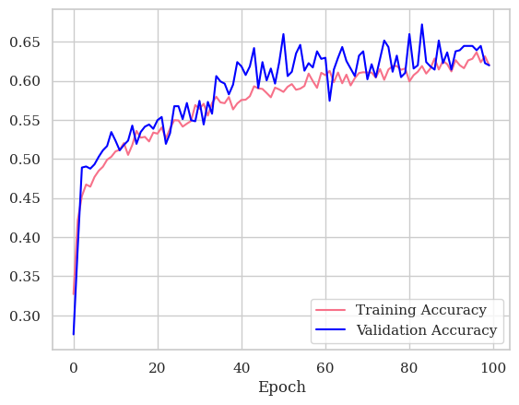
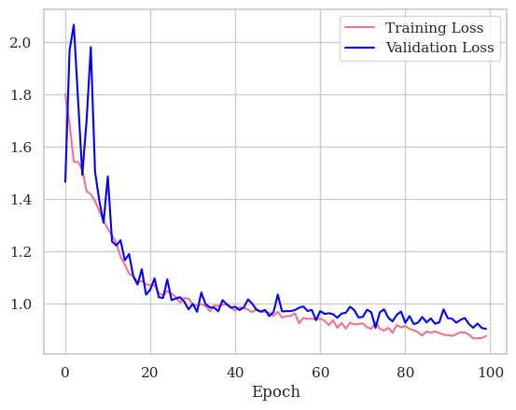
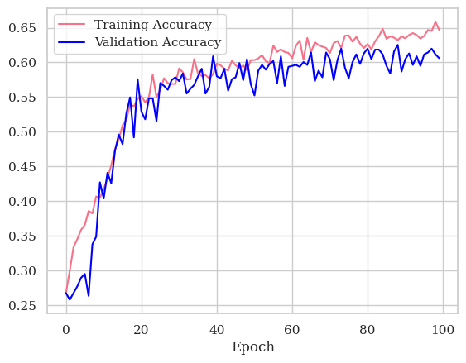
Training curves
MLP Classifier
Conv LSTM
EEGNet
Deep ConvNet
Group 18
Benchmarking and Analysis of Deep Learning methods to classify EEG Motor Movement / Imagery signals

Slide 9
Preliminary Results
Models | Feature Extraction | Accuracy | F1 | Acc-Noise | F1-Noise
MLP | Raw-filtered | 0.2390 | 0.0922 | 0.2307 | 0.0865
EEGNet | Raw-filtered | 0.6073 | 0.6040 | 0.5449 | 0.5365
Shallow ConvNet | Raw-filtered | 0.5617 | 0.5632 | 0.5296 | 0.5317
Deep ConvNet | Raw-filtered | 0.5990 | 0.5934 | 0.5764 | 0.5741
ATCNet | Raw-filtered | 0.6658 | 0.6643 | 0.6034 | 0.6021
EEGConformer | Raw-filtered | 0.4949 | 0.4922 | 0.4916 | 0.4901
ShallowFBCSPNet | FBCSP | 0.5893 | 0.5885 | 0.5893 | 0.5879
Group 18
Benchmarking and Analysis of Deep Learning methods to classify EEG Motor Movement / Imagery signals

Slide 10
Preliminary Results
Models | Feature Extraction | Accuracy | F1 | Acc-Noise | F1-Noise
EEGNet-v1 | Raw-filtered | 0.5450 | 0.5420 | 0.5536 | 0.5416
Deep4Net | Raw-filtered | 0.5347 | 0.5223 | 0.5302 | 0.5221
EEGITNet | Raw-filtered | 0.5964 | 0.5842 | 0.5597 | 0.5508
MLP | CSP | 0.3689 | 0.3285 | 0.2734 | 0.2564
CNN | CSP | 0.3281 | 0.3177 | 0.2647 | 0.2556
Conv-LSTM | CSP | 0.3463 | 0.3294 | 0.2960 | 0.2799
Group 18
Benchmarking and Analysis of Deep Learning methods to classify EEG Motor Movement / Imagery signals

Slide 11
Future Steps
Fine-tuning the models
Other datasets - Physionet
Other models - HybridConvNet, FusionNet
Robustness Testing - Synthetic Data, Saliency map attack, DeepFool attack
Group 18
Benchmarking and Analysis of Deep Learning methods to classify EEG Motor Movement / Imagery signals
Notes:
Saliency map attack - jacobian based - Find feature whose modification maximizes prob of incorrect class or min the prob of correct class
Deepfool - Iteratively push input data towards decision boundary until it crosses class boundary

Slide 12
References
D. Milanés Hermosilla et al., "Shallow Convolutional Network Excel for Classifying Motor Imagery EEG in BCI Applications," IEEE Access, vol. 9, June 2021, doi: 10.1109/ACCESS.2021.3091399.
N. Shajil, M. Sasikala, and A. M. Arunagiri, "Deep Learning Classification of two-class Motor Imagery EEG signals using Transfer Learning," in Proc. 8th IEEE International Conference on E-Health and Bio engineering (EHB), Grigore T. Popa University of Medicine and Pharmacy, Romania, Oct. 2020.
D. Avola, M. Cascio, L. Cinque, A. Fagioli, G. L. Foresti, M. R. Marini, and D. Pannone, "Analyzing EEG Data with Machine and Deep Learning: A Benchmark," arXiv:2203.10009v1 [cs.LG], Mar. 2022.
Group 18
Benchmarking and Analysis of Deep Learning methods to classify EEG Motor Movement / Imagery signals

Slide 13
Guided by: Yuehan Qin - TA
Team Members:
Jack Praveen Raj Ilango
Jayanth Jayakumar
Neranjhana Ramesh
Pragatheeswaran Ravichandran
Sathiya Murthi Sankaran
Sriram Acharya
Group 18
Benchmarking and Analysis of Deep Learning methods to classify EEG Motor Movement / Imagery signals

